Slide 1
Projektowanie złożonych systemów telekomunikacyjnych
Lecture 1: UML – Introduction
Łukasz Marchewka
04-03-2021

Slide 2
Agenda:
What is the Modelling and UML
Understanding the basics of UML
UML diagrams
Structural diagrams
Behavioral diagrams
Interaction diagrams
UML Modeling tools
OpenSource Tool - PlantUML

Slide 3
Modelling
Describing a system at a high level of abstraction
A model of the system
Used for requirements and specifications
Why do we model software systems?
A model is a simplification, that helps in better understanding of the system
Notes:
Modelowanie to opis systemu na odpowiednim poziomie abstrakcji, który pozwala zrozumieć jego złożoność Describing the system at abstract level to comprehend its complexity
Necessary to manage complexity
Good for quick understanding of the systems
Less chances of conflicting views b/w end-user and system designers
Evolution of analysis and design techniques
Transition from structured programming to object oriented programming

Slide 4
UML – Unified Modelling Language
UML is a pictorial language for specifying, visualizing, constructing, and documenting the artifacts of software systems
It is a simple modeling mechanism to model all possible practical systems
UML is not a programming language but there are tools that can be used to generate code in various languages basing on UML diagrams
UML is not dependent on any language or technology
Notes:
UML is a standard language for specifying, visualizing, constructing, and documenting the artifacts of software systems.
UML was created by Object Management Group and UML 1.0 specification draft was proposed to the OMG in January 1997.
a general purpose visual modeling language to visualize, specify, construct and document software system.
Use graphical notation to communicate more clearly than natural language (imprecise) and code(too detailed).
Help acquire an overall view of a system.
UML is not dependent on any one language or technology.
UML moves us from fragmentation to standardization.
. More precise than natural language … less detailed than source code
. Not dependent on any language
. Standardized by various groups

Slide 5
Diagrams
Structural Diagrams – describe static aspects of the software system using :
Objects
Attributes
Operations and relationships
Behavioral (or Dynamic) Diagrams – describe dynamic aspects of the software system by showing collaboration among objects and changes to the internal states of objects:
Use-case
Interaction
State Chart
Activity
Notes:
UML składa się z pewnych elementów graficznych, i słów kluczowych powiązanych ze sobą w diagramy, które pokazują modele rzeczywistości
Diagram to uproszczona reprezentacja graficzna pewnych pomysłów, idei, konstrukcji, zależności, danych statystycznych itp.
Rodzaje diagramów
Diagramy strukturalne
Diagramy dynamiczne

Slide 6
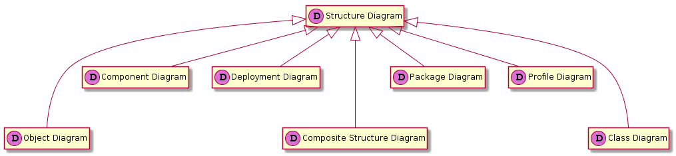
Structure Diagrams Hierarchy (Static)
Notes:
Structure diagrams show static structure of the system and its parts on different abstraction and implementation levels and how those parts are related to each other. The elements in a structure diagram represent the meaningful concepts of a system, and may include abstract, real world and implementation concepts.
Structure diagrams are not utilizing time related concepts, do not show the details of dynamic behavior. However, they may show relationships to the behaviors of the classifiers exhibited in the structure diagrams.
Diagram
Purpose
Elements
Class diagram
Shows structure of the designed system, subsystem or component as related classes and interfaces, with their features, constraints and relationships - associations, generalizations, dependencies, etc.
class, interface, feature, constraint, association, generalization, dependency.
Object diagram
Instance level class diagram which shows instance specifications of classes and interfaces (objects), slots with value specifications, and links (instances of association).
Object diagram was defined in now obsolete UML 1.4.2 Specification as "a graph of instances, including objects and data values. A static object diagram is an instance of a class diagram; it shows a snapshot of the detailed state of a system at a point in time." It also stated that object diagram is "a class diagram with objects and no classes."
UML 2.5 specification simply provides no definition of object diagram.
instance specification, object, slot, link.
Package diagram
Shows packages and relationships between the packages.
package, packageable element, dependency, element import, package import, package merge.
Model diagram
UML auxiliary structure diagram which shows some abstraction or specific view of a system, to describe architectural, logical or behavioral aspects of the system. It could show, for example, architecture of a multi-layered (aka multi-tiered) application - see multi-layered application model.
model, package, packageable element, dependency.
Composite structure diagram
Diagram could be used to show:
Internal structure of a classifier
A behavior of a collaboration
Internal structure diagram
Shows internal structure of a classifier - a decomposition of the classifier into its properties, parts and relationships.
structured class, part, port, connector, usage.
Collaboration use diagram
Shows objects in a system cooperating with each other to produce some behavior of the system.
collaboration, connector, part, dependency.
Component diagram
Shows components and dependencies between them. This type of diagrams is used for Component-Based Development (CBD), to describe systems with Service-Oriented Architecture (SOA).
component, interface, provided interface, required interface, class, port, connector, artifact, component realization, usage.
Manifestation diagram
While component diagrams show components and relationships between components and classifiers, and deployment diagrams - deployments of artifacts to deployment targets, some missing intermediate diagram is manifestation diagram to be used to show manifestation (implementation) of components by artifacts and internal structure of artifacts.
Because manifestation diagrams are not defined by UML 2.5 specification, manifestation of components by artifacts could be shown using either component diagrams or deployment diagrams.
manifestation, component, artifact.
Deployment diagram
Shows architecture of the system as deployment (distribution) of software artifacts to deployment targets.
Note, that components were directly deployed to nodes in UML 1.x deployment diagrams. In UML 2.x artifacts are deployed to nodes, and artifacts could manifest (implement) components. Components are deployed to nodes indirectly through artifacts.
Specification level deployment diagram (also called type level) shows some overview of deployment of artifacts to deployment targets, without referencing specific instances of artifacts or nodes.
Instance level deployment diagram shows deployment of instances of artifacts to specific instances of deployment targets. It could be used for example to show differences in deployments to development, staging or production environments with the names/ids of specific build or deployment servers or devices.
deployment, artifact, deployment target, node, device, execution environment, communication path, deployment specification,
Network architecture diagram
Deployment diagrams could be used to show logical or physical network architecture of the system. This kind of deployment diagrams - not formally defined in UML 2.5 - could be called network architecture diagrams.
node, switch, router, load balancer, firewall, communication path, network segment, backbone.
Profile diagram
Auxiliary UML diagram which allows to define custom stereotypes, tagged values, and constraints as a lightweight extension mechanism to the UML standard. Profiles allow to adapt the UML metamodel for different
platforms (such as J2EE or .NET), or
domains (such as real-time or business process modeling).
Profile diagrams were first introduced in UML 2.0.
profile, metaclass, stereotype, extension, reference, profile application.

Slide 7
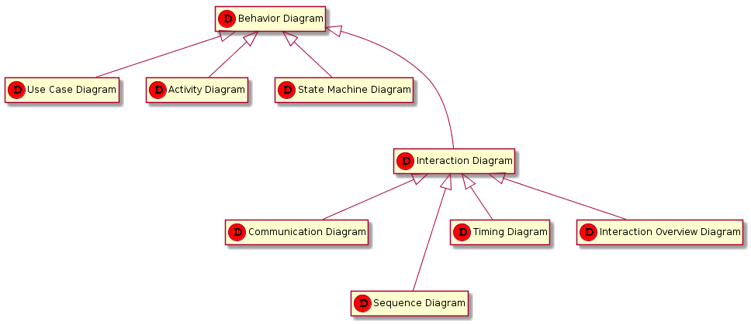
Behavioral (Dynamic) Diagrams Hierarchy
Notes:
Diagramy sekwencji - opisują interakcje pomiędzy częściami systemu w postaci sekwencji komunikatów wymienianych między nimi
Diagramy komunikacji - specyfikują strukturalne związki pomiędzy biorącymi udział w interakcji częściami oraz wymianę komunikatów pomiędzy tymi instancjami.
Diagramy czasowe - reprezentują na osi czasu zmiany dopuszczalnych stanów, jakie może przyjmować uczestnik w interakcji
Przeglądowe diagramy interakcji - udostępniają wysokiego poziomu widok wzajemnej współpracy kilku interakcji wykorzystujących w celu implementacji pewnej części systemu, na przykład danego przypadku użycia
class "Diagram przypadków użycia" << (D,red) >>
class "Diagram aktywności" << (D,red) >>
class "Diagram maszyny stanów" << (D,red) >>
class "Diagramy interakcji" << (D,red) >>
class "Diagram komunikacji" << (D,red) >>
class "Diagram sekwencji" << (D,red) >>
class "Diagram czasowy" << (D,red) >>
class "Diagram przeglądu interakcji" << (D,red) >>
class "Diagram Zachowań" << (D,red) >>
"Diagram Zachowań" <|--- "Diagram przypadków użycia"
"Diagram Zachowań" <|-- "Diagram aktywności"
"Diagram Zachowań" <|--- "Diagram maszyny stanów"
"Diagram Zachowań" <|--- "Diagramy interakcji"
"Diagram Zachowań" <|-- "Diagram komunikacji"
"Diagram Zachowań" <|--- "Diagram sekwencji"
"Diagram Zachowań" <|-- "Diagram czasowy"
"Diagram Zachowań" <|-- "Diagram przeglądu interakcji"
hide members

Slide 8
Structure Diagrams

Slide 9
Class Diagram
Class Diagram describes static structure of a system using:
Classes/Interfaces
Attributes
Operations (or methods)
Relationships between classes
Notes:
UML składa się z pewnych elementów graficznych, i słów kluczowych powiązanych ze sobą w diagramy, które pokazują modele rzeczywistości
Diagram to uproszczona reprezentacja graficzna pewnych pomysłów, idei, konstrukcji, zależności, danych statystycznych itp.
Rodzaje diagramów
Diagramy strukturalne
Diagramy dynamiczne

Slide 10
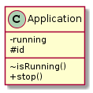
Class
Describes a set of objects having similar:
Attributes (status)
Operations (behavior)
Relationships with other classes
Attributes and operations may have their visibility marked:
"+" for public
"#" for protected
"−" for private
"~" for package
Notes:
UML składa się z pewnych elementów graficznych, i słów kluczowych powiązanych ze sobą w diagramy, które pokazują modele rzeczywistości
Diagram to uproszczona reprezentacja graficzna pewnych pomysłów, idei, konstrukcji, zależności, danych statystycznych itp.
Rodzaje diagramów
Diagramy strukturalne
Diagramy dynamiczne

Slide 11
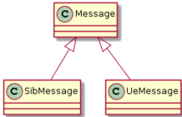

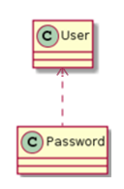
Class diagram – replationships between classes
Generalization:
Indicates that objects of the specialized class (subclass) are substitutable for objects of the generalized class (super-class)
Generalization expresses a parent/child relationship among related classes
Used for abstracting details in several layers
Association:
Indicates that there is a relationship between objects,
however the objects are independent
Dependency:
An element, or set of elements, requires other model elements for their specification or implementation
Notes:
UML składa się z pewnych elementów graficznych, i słów kluczowych powiązanych ze sobą w diagramy, które pokazują modele rzeczywistości
Diagram to uproszczona reprezentacja graficzna pewnych pomysłów, idei, konstrukcji, zależności, danych statystycznych itp.
Rodzaje diagramów
Diagramy strukturalne
Diagramy dynamiczne

Slide 12

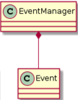
Class diagram – replationships between classes
Aggregation:
It can be treated as variant of the "has a" association relationship.
It represents a part-whole or part-of relationship.
Composition:
A strong form of aggregation
Whole/part relationship -> The whole is the sole owner of its part
If a composite (whole) is deleted, all of its composite parts are also deleted
Notes:
UML składa się z pewnych elementów graficznych, i słów kluczowych powiązanych ze sobą w diagramy, które pokazują modele rzeczywistości
Diagram to uproszczona reprezentacja graficzna pewnych pomysłów, idei, konstrukcji, zależności, danych statystycznych itp.
Rodzaje diagramów
Diagramy strukturalne
Diagramy dynamiczne

Slide 13
Behavioral Diagrams

Slide 14
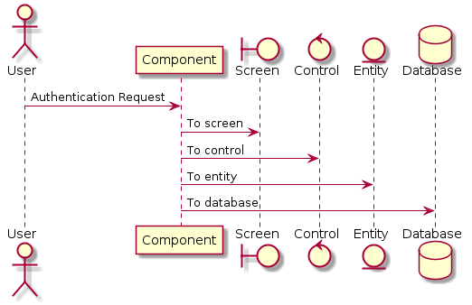
Sequence Diagram
Describes the interactions between objects in the sequential order
The diagram conveys this information along the horizontal and vertical dimensions:
the vertical dimension shows, top down, the time sequence of messages/calls as they occur, and the horizontal dimension shows, left to right, the object instances that the messages are sent to.
Notes:
UML składa się z pewnych elementów graficznych, i słów kluczowych powiązanych ze sobą w diagramy, które pokazują modele rzeczywistości
Diagram to uproszczona reprezentacja graficzna pewnych pomysłów, idei, konstrukcji, zależności, danych statystycznych itp.
Rodzaje diagramów
Diagramy strukturalne
Diagramy dynamiczne

Slide 15
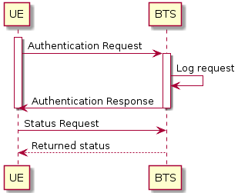
Sequence Diagram
Lifeline:
A vertical line that represents the sequence of events that occur in a participant during an interaction, while time progresses down the line. This participant can be an instance of a class, component, or actor.
Messages:
Messages are arrows that represent communication between objects. Half-arrowed lines are used to represent asynchronous messages. Asynchronous messages are sent from an object that will not wait for a response from the receiver before continuing its tasks.
Activation boxes:
Represent the time an object needs to complete a task. When an object is busy executing a process or waiting for a reply message, use a thin rectangle placed vertically on
Notes:
UML składa się z pewnych elementów graficznych, i słów kluczowych powiązanych ze sobą w diagramy, które pokazują modele rzeczywistości
Diagram to uproszczona reprezentacja graficzna pewnych pomysłów, idei, konstrukcji, zależności, danych statystycznych itp.
Rodzaje diagramów
Diagramy strukturalne
Diagramy dynamiczne

Slide 16
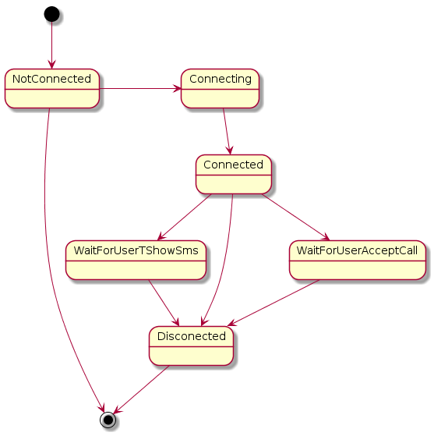
State (Machine) Diagram
Describes the behavior of a single object and the flow of control from one state to another
Specifies a sequence of events that an object goes through during its lifetime in response to events.
Notes:
State diagrams describe all the possible states that a particular object can get into and how the object’s state changes as a result of events that reach the object.

Slide 17


State (Machine) Diagram
State is defined as a condition in which an object exists and it changes when some event is triggered
Initial State:
A filled circle followed by an arrow represents the object's initial state
Final State:
An arrow pointing to a filled circle nested inside another circle represents the object's final state
Transition:
A solid arrow represents the path between different states of an object. Label the transition with the event that triggered it and the action that results from it. A state can have a transition that points back to itself
Decision points:
A decision point models a choice that must be made within the sequence of states
Notes:
State diagrams describe all the possible states that a particular object can get into and how the object’s state changes as a result of events that reach the object.

Slide 18
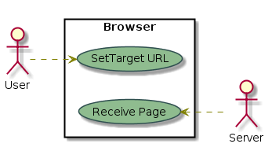
Use case diagram
Ilustrates a unit of functionality provided by the system.
Visualizes the different types of roles in a system and how those roles interact with the system.
Identify functions and how roles interact with them
High level view of the system
Identify internal and external factors
Notes:
State diagrams describe all the possible states that a particular object can get into and how the object’s state changes as a result of events that reach the object.

Slide 19



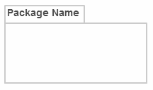
Use Case Diagram objects
Use case diagrams consist of 4 objects:
Actor:
Any entity that performs a role in one given system. This could be a person, organization or an external system
Use case:
Represents a function or an action within the system.
System (optional):
Defines the scope of the use case, an optional element but useful when your visualizing large systems.
Package (optional):
Used to group use cases together.
Notes:
To identify functions and how roles interact with them – The primary purpose of use case diagrams.
For a high level view of the system – Especially useful when presenting to managers or stakeholders. You can highlight the roles that interact with the system and the functionality provided by the system without going deep into inner workings of the system.
To identify internal and external factors – This might sound simple but in large complex projects a system can be identified as an external role in another use case.

Slide 20
PlantUML
PlantUML is an Open Source project used to draw UML diagram, using a simple and human readable text description.
It's more a drawing tool than a modeling tool.
http://plantuml.com/
Notes:
State diagrams describe all the possible states that a particular object can get into and how the object’s state changes as a result of events that reach the object.

Slide 22
Copyright and confidentiality
The contents of this document are proprietary and confidential property of Nokia. This document is provided subject to confidentiality obligations of the applicable agreement(s).
This document is intended for use of Nokia’s customers and collaborators only for the purpose for which this document is submitted by Nokia. No part of this document may be reproduced or made available to the public or to any third party in any form or means without the prior written permission of Nokia. This document is to be used by properly trained professional personnel. Any use of the contents in this document is limited strictly to the use(s) specifically created in the applicable agreement(s) under which the document is submitted. The user of this document may voluntarily provide suggestions, comments or other feedback to Nokia in respect of the contents of this document ("Feedback"). Such Feedback may be used in Nokia products and related specifications or other documentation. Accordingly, if the user of this document gives Nokia Feedback on the contents of this document, Nokia may freely use, disclose, reproduce, license, distribute and otherwise commercialize the feedback in any Nokia product, technology, service, specification or other documentation.
Nokia operates a policy of ongoing development. Nokia reserves the right to make changes and improvements to any of the products and/or services described in this document or withdraw this document at any time without prior notice.
The contents of this document are provided "as is". Except as required by applicable law, no warranties of any kind, either express or implied, including, but not limited to, the implied warranties of merchantability and fitness for a particular purpose, are made in relation to the accuracy, reliability or contents of this document. NOKIA SHALL NOT BE RESPONSIBLE IN ANY EVENT FOR ERRORS IN THIS DOCUMENT or for any loss of data or income or any special, incidental, consequential, indirect or direct damages howsoever caused, that might arise from the use of this document or any contents of this document.
This document and the product(s) it describes are protected by copyright according to the applicable laws.
Nokia is a registered trademark of Nokia Corporation. Other product and company names mentioned herein may be trademarks or trade names of their respective owners.

Slide 23
Revision history and metadata
Please delete this slide if document is uncontrolled
Document ID: DXXXXXXXXX Document Location: Organization:
Version | Description of changes | Date | Author | Owner | Status | Reviewed by | Reviewed date | Approver | Approval date
 |  | DD-MM-YYYY |  |  |  |  | DD-MM-YYYY |  | DD-MM-YYYY

